Slide 1
Lord of The Rings Analysis

Slide 2


Our team
Anca Ariesanu
Eric Florea

Slide 3
Table of contents
01
Introduction
02
Sentiment Analysis
03
Diagrams
04
Conclusions
Presenting the dataset and the books themselves
Sentiment Analysis for each chapter, book and overall series
Data Visualization, Language Model(TF-IDF, N-grams, PoS, Wordcloud)

Slide 4
01
Introduction

Slide 5
The plot of the book
"The Lord of the Rings" by J.R.R. Tolkien is an epic fantasy trilogy that follows hobbit Frodo Baggins as he embarks on a quest to destroy the One Ring, a powerful artifact created by the dark lord Sauron. Joined by the Fellowship, including Aragorn, Gandalf, Legolas, Gimli, and fellow hobbits Sam, Merry, and Pippin, Frodo faces numerous trials, including battles against Sauron's forces and the treachery of Gollum. The narrative splits, with Frodo and Sam heading to Mordor while others aid in Middle-earth's defense. Key events include the Battle of Helm’s Deep and the final confrontation at the Black Gate. The Ring is destroyed when Gollum seizes it and falls into Mount Doom. Peace is restored, Aragorn is crowned king, and the hobbits return home. The saga ends with Frodo and other key characters departing for the Undying Lands, symbolizing the end of their journey and the passing of an age.

Slide 6
Data Cleaning & Preprocessing
How we got the data
How we divided our data
How we filtered the words
We got the data from a github repository, in a text file form
We used regex to filter out when a book or chapter starts and we save it in our dataframe.
We removed any special characters and unnecessary whitespaces, we left only alphanumeric characters.

Slide 7
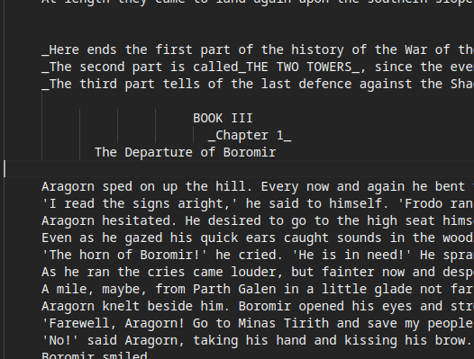


Characteristics of the Dataset
Book Division
Chapter Division
The series is composed by 6 books, numerotated by roman numerals
Each book has between 10-12 chapters, written as _Chapter X_

Slide 8
02
Sentiment Analysis

Slide 9
-0.377
The sentiment value has the range of [-1, 1].
Overall Sentiment Value

Slide 10
Sentimental value of each volume
Book 1
Book 2
Book 3
Book 4
Book 5
Book 6
The Fellowship of the Ring
Vol. 1
The Fellowship of the Ring
Vol. 2
The Two Towers Vol. 1
The Two Towers Vol. 2
The Return of the King Vol. 1
The Return of the King Vol. 2
-0.426
-0.264
-0.355
-0.584
-0.341
-0.208

Slide 11
The saddest book
Book 4
Frodo and Sam, guided by the treacherous Gollum, continue their journey to Mordor. They pass through the Dead Marshes and avoid the Black Gate. Gollum leads them to Ithilien, where they meet Faramir, who resists the temptation of the Ring and helps them. Gollum then takes them to the pass of Cirith Ungol, where Frodo is captured by the giant spider Shelob. Believing Frodo dead, Sam takes the Ring but soon discovers Frodo is alive and held by orcs. Determined, Sam sets out to rescue him.

Slide 12
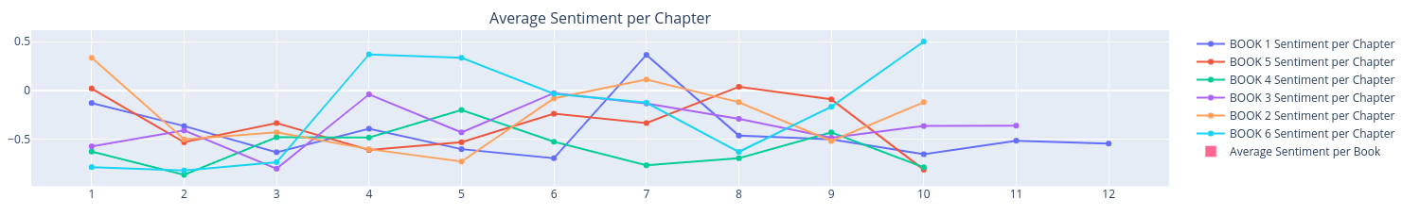
Sentiment Analysis of each chapter per book
Book 6 has the best peek moment from chapter 3 to 4.
Book 4 is not the most predictable, having a negative feeling in every chapter, lacking variation in sentiment score.
Around the end of each book, the sentiment score rises accordingly.

Slide 13
03
Diagrams

Slide 14

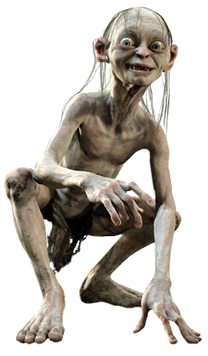
A picture is worth a thousand words

Slide 15
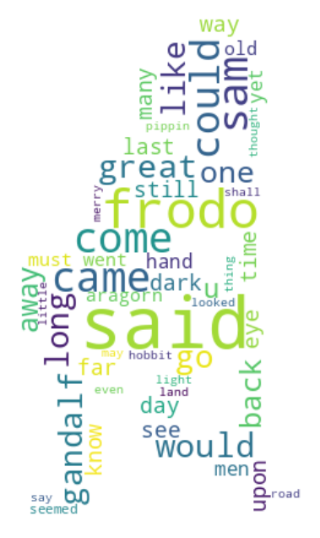
A picture is worth a thousand words

Slide 16
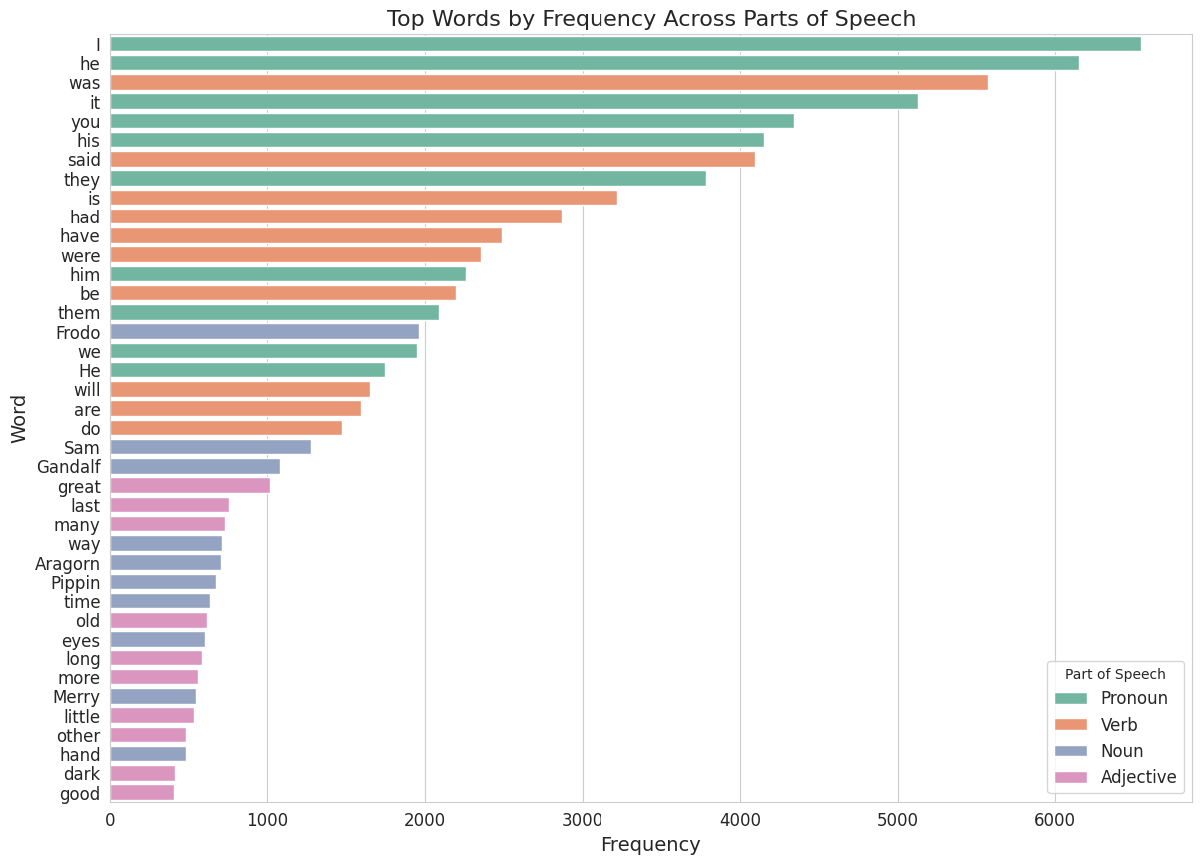

Slide 17
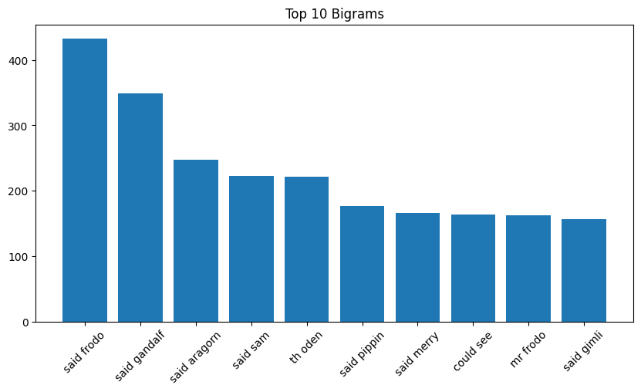
Words profile
say
583
Frodo
1970
The most common words
said
4097
1
Characters names
road
598
Frodo, Gandalf,Pippin, Marry etc…
2
Verbs
The story is based on actions of characters
3
Nouns
Which describes the journey they had

Slide 18
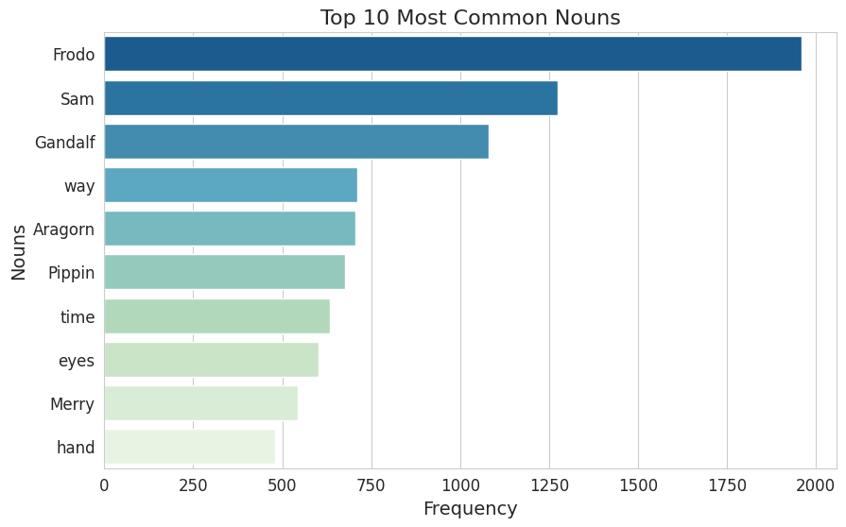
Nouns that matters

Slide 19
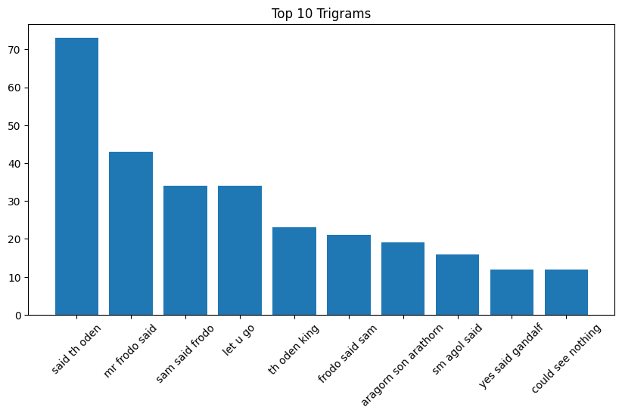

Slide 20
04
Conclusions

Slide 21

What we learned from this?
The Sentiment Analysis is not 100% certain since most of the narrative is from the past explaining the bad times, even if the present is in a good mood. Because of this the story is seen is somewhat sad but that's the limitation of the model we used, context is very important.
1
3
The narrative is mostly written in third person by the abundance of bigrams and trigrams in the third person.
Frodo, sam and Gandalf are very important characters in the story.
4
The books follow a pattern such that all books apart from the forth one have the ending chapters better sentiment scores.
2

Slide 22
Thanks
Do you have any questions?

Slide 23
Resources
01
Github repo for project code
02
Github repo for book
03
Knowledge
https://github.com/ancaariesanu/DM_Project_LordOfTheRings
https://github.com/ganesh-k13/shell/tree/master/test_search/www.glozman.com/TextPages
Data mining lab papers from CV

